Slide 1

Force, Momentum and Impulse
Ejalo academy

Slide 2
Force

Slide 3
Force
A force is anything that can cause a change to objects.
Forces can:
• change the shape of an object
• move or stop an object
• change the direction of a moving object.

Slide 4
Examples
Gravitational Forces
Gravity is the attractive force between two objects due to the mass of the objects. When you throw a ball in the air, its mass and the Earth’s mass attract each other, which leads to a force between them. The ball falls back towards the Earth, and the Earth accelerates towards the ball. The movement of the Earth towards the ball is, however, so small that you couldn’t possibly measure it.

Slide 5
Examples
Electromagnetic Forces
Almost all of the forces that we experience in everyday life are electromagnetic in origin. They have this unusual name because long ago people thought that electric forces and magnetic forces were different things. After much work and experimentation, it has been realised that they are actually different manifestations of the same underlying theory.

Slide 6
Examples
Electromagnetic Forces
Almost all of the forces that we experience in everyday life are electromagnetic in origin. They have this unusual name because long ago people thought that electric forces and magnetic forces were different things. After much work and experimentation, it has been realised that they are actually different manifestations of the same underlying theory.

Slide 7
Examples
Electric or Electrostatic Forces
If we have objects carrying electrical charge, which are not moving, then we are dealing with electrostatic forces (Coulomb’s Law). This force is actually much stronger than gravity. This may seem strange, since gravity is obviously very powerful, and holding a balloon to the wall seems to be the most impressive thing electrostatic forces have done, but if we think about it: for gravity to be detectable, we need to have a very large mass nearby. But a balloon rubbed in someone’s hair can stick to a wall with a force so strong that it overcomes the force of gravity—with just the charges in the balloon and the wall!

Slide 8
Examples
Magnetic Forces
The magnetic force is a different manifestation of the electromagnetic force. It stems from the interaction between moving charges as opposed to the fixed charges involved in Coulomb’s Law. Examples of the magnetic force in action include magnets, compasses, car engines and computer data storage. Magnets are also used in the wrecking industry to pick up cars and move them around sites.

Slide 9
Examples
Friction
According to Newton’s First Law (we will discuss this later in the chapter) an object moving without a force acting on it will keep on moving. Then why does a box sliding on a table stop? The answer is friction. Friction arises from the interaction between the molecules on the bottom of a box with the molecules on a table. This interaction is electromagnetic in origin, hence friction is just another view of the electromagnetic force. Later in this chapter we will discuss frictional forces a little more.

Slide 10
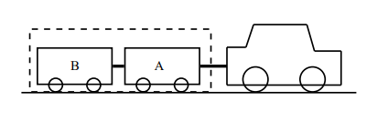
System and External Forces

Slide 11
System and External Forces
Following External forces will apply:
The force of the car pulling the unit (trailer A and B)
The force of friction between the wheels of the trailers and the road (opposite to the direction of motion)
The force of the Earth pulling downwards on the system (gravity)
The force of the road pushing upwards on the system

Slide 12
System and External Forces
Following forces will not apply:
The force of A pulling B
The force of B pulling A
The force of friction between the wheels of the car and the road (opposite to the direction of motion)

Slide 13
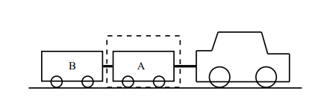
System and External Forces
Considering trailer A as a system, following external forces will apply:
The force of the car pulling on A (towards the right)
The force of B pulling on A (towards the left)
The force of the Earth pulling downwards on the trailer (gravity)
The force of the road pushing upwards on the trailer

Slide 14
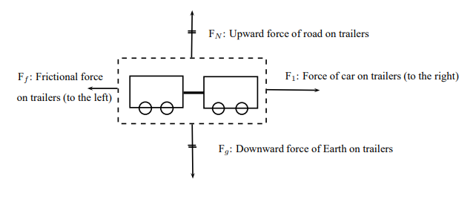
Force diagrams

Slide 15
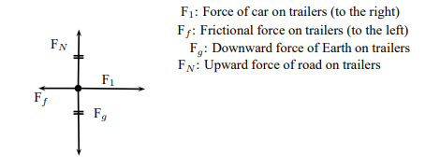
Free Body Diagrams

Slide 16

Finding the Resultant Force

Slide 17

Finding the Resultant Force

Slide 18
Exercise: Finding the resultant Force
Question: A car (mass 1200 kg) applies a force of 2000 N on a trailer (mass 250 kg). A constant frictional force of 200 N is acting on the trailer, and 300 N is acting on the car.
Draw a force diagram of all the forces acting on the car.
Draw a free body diagram of all the horizontal forces acting on the trailer.
3. Use the force diagram to determine the resultant force on the trailer.

Slide 19

Newton’s First Law

Slide 20
Newton’s First Law
Example:
Rockets
Seat belts

Slide 21
Exercise: Newton’s First Law
Question: Why do passengers get thrown to the side when the car they are driving in goes around a corner?

Slide 22
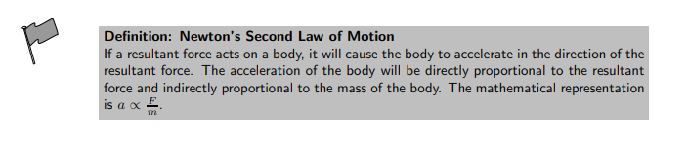
Newton’s Second Law of Motion ( F = ma)

Slide 23
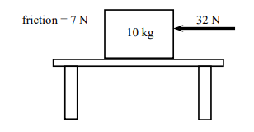
Exercise: Newton II – Box on a surface 1
Question: A 10 kg box is placed on a table. A horizontal force of 32 N is applied to the box. A frictional force of 7 N is present between the surface and the box.
Draw a force diagram indicating all the horizontal forces acting on the box.
2. Calculate the acceleration of the box.

Slide 24
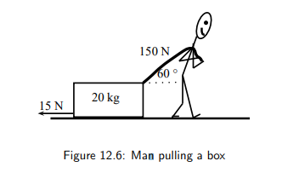
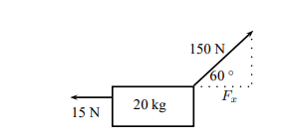
Exercise: Newton II – Man pulling a box
Question: A man is pulling a 20 kg box with a rope that makes an angle of 60◦ with the horizontal. If he applies a force of 150 N and a frictional force of 15 N is present, calculate the acceleration of the box.

Slide 25

Newton’s Third Law of Motion

Slide 26

Example: Newton III Seat Belt
Question: Ram is seated in the passenger seat of a car with the seat belt on. The car suddenly stops and he moves forwards until the seat belt stops him. Draw a labeled force diagram identifying two action-reaction pairs in this situation.

Slide 27
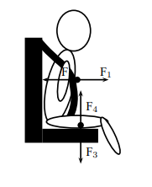
Example: Newton III Seat Belt
Question: Ram is seated in the passenger seat of a car with the seat belt on. The car suddenly stops and he moves forwards until the seat belt stops him. Draw a labeled force diagram identifying two action-reaction pairs in this situation.
F1: The force of Ram on the seat belt
F2 : The force of the seat belt on Ram
F3: The force of Ram on the seat (downwards)
F4: The force of the seat on Ram (upwards)

Slide 28
Different Types of Forces
Tension
Tension is the magnitude of the force that exists in objects like ropes, chains and struts that are providing support. For example, there are tension forces in the ropes supporting a child’s swing hanging from a tree.

Slide 29
Different Types of Forces
Contact and non-contact Forces
Contact Forces: push or a pull, tension in a string, frictional forces and the normal
Non-contact Forces: magnetic forces, electrostatic forces and gravitational forces

Slide 30
Different Types of Forces
Normal force
A 5 kg box is placed on a rough surface and a 10 N force is applied at an angle of 36,9◦ to the horizontal. The box does not move. The normal force (N or FN ) is the force between the box and the surface acting in the vertical direction. If this force is not present the box would fall through the surface because the force of gravity pulls it downwards. The normal force therefore acts upwards. We can calculate the normal force by considering all the forces in the vertical direction. All the forces in the vertical direction must add up to zero because there is no movement in the vertical direction.

Slide 31
Example: Forces on a slope
Question: A 50 kg crate is placed on a slope that makes an angle of 30◦ with the horizontal. The box does not slide down the slope. Calculate the magnitude and direction of the frictional force and the normal force present in this situation

Slide 32

Forces in equilibrium

Slide 33
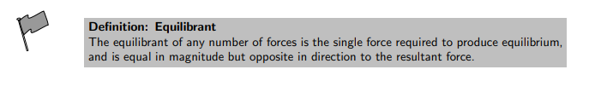
Forces in equilibrium

Slide 34
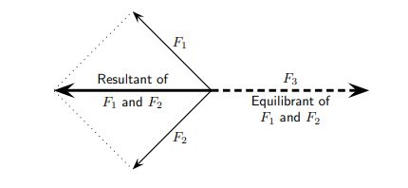
Forces in equilibrium
F1, F2 and F3 are in equilibrium
F3 is the equilibrant of F1 and F2
F1 and F2 are kept in equilibrium by F3

Slide 35
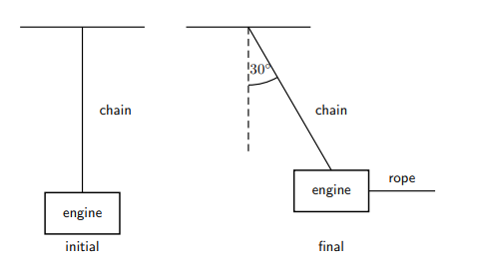
Example: Equilibrium
Question: A car engine of weight 2000 N is lifted by means of a chain and pulley system. The engine is initially suspended by the chain, hanging stationary. Then, the engine is pulled sideways by a mechanic, using a rope. The engine is held in such a position that the chain makes an angle of 30◦ with the vertical. In the questions that follow, the masses of the chain and the rope can be ignored.
Draw a free body representing the forces acting on the engine in the initial situation.
Determine the tension in the chain initially.
Draw a free body diagram representing the forces acting on the engine in the final situation.
Determine the magnitude of the applied force and the tension in the chain in the final situations.

Slide 36
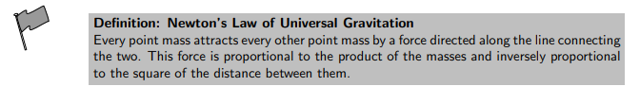

Force between Masses ( F = mg)
The magnitude of the attractive gravitational force between the two point masses, F is given by:

Slide 37

Momentum and Impulse
The momentum (symbol p) of an object of mass m moving at velocity v is: p = m · v

Slide 38

Momentum and Impulse
Different objects can also have the same momentum, for example a car travelling slowly can have the same momentum as a motor cycle travelling relatively fast. We can easily demonstrate this. Consider a car of mass 1 000 kg with a velocity of 8 m/s(about 30 km/hr). The momentum of the car is therefore

Slide 39

Momentum and Impulse
Different objects can also have the same momentum, for example a car travelling slowly can have the same momentum as a motor cycle travelling relatively fast. We can easily demonstrate this. Consider a car of mass 1 000 kg with a velocity of 8 m/s(about 30 km/hr). The momentum of the car is therefore
Now consider a motor cycle of mass 250 kg travelling at 32 m/s(about 115 km/hr). The momentum of the motor cycle is:

Slide 40
Momentum and Impulse
Different objects can also have the same momentum, for example a car travelling slowly can have the same momentum as a motor cycle travelling relatively fast. We can easily demonstrate this.
Consider a car of mass 1 000 kg with a velocity of 8 m/s(about 30 km/hr). The momentum of the car is therefore
Now consider a motor cycle of mass 250 kg travelling at 32 m/s(about 115 km/hr). The momentum of the motor cycle is:
Even though the motor cycle is considerably lighter than the car, the fact that the motor cycle is travelling much faster than the car means that the momentum of both vehicles is the same.

Slide 41

Vector Nature of Momentum
Momentum is a vector quantity. Since momentum is a vector, the techniques of vector addition discussed in Chapter Vector must be used to calculate the total momentum of a system.

Slide 42

Impulse
Mathematically, Newton’s Second law can be stated as:
Impulse is the product of the net force and the time interval for which the force acts. Impulse is defined as:

Slide 43
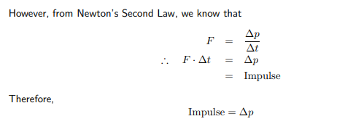
Impulse

Slide 44
Exercise: Impulse and Change in Momentum
Question: A 150 N resultant force acts on a 300 kg trailer. Calculate how long it takes this force to change the trailer’s velocity from 2 m·s −1 to 6 m·s −1 in the same direction. Assume that the forces acts to the right.

Slide 45

Conservation of Momentum
This means that in an isolated system the total momentum before a collision or explosion is equal to the total momentum after the collision or explosion.

Slide 46

Conservation of Momentum
Before the collision
The total momentum of the system before the collision, p(initial) is:

Slide 47


Conservation of Momentum
Before the collision
After the collison
The total momentum of the system before the collision,
p(final) is:
The total momentum of the system before the collision, p(initial) is:

Slide 48
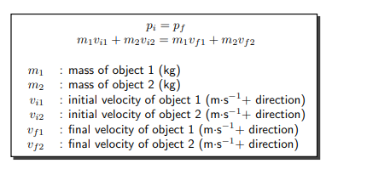
Conservation of momentum

Slide 49
Exercise: Conservation of Momentum
Question: A toy car of mass 1 kg moves westwards with a speed of 2 m·s −1 . It collides head-on with a toy train. The train has a mass of 1,5 kg and is moving at a speed of 1.5 m·s −1 eastwards. If the car rebounds at 2.05 m·s −1 , calculate the velocity of the train

Slide 50
Summary
Newton’s First Law Every object will remain at rest or in uniform motion in a straight line unless it is made to change its state by the action of an unbalanced force.

Slide 51
Summary
Newton’s First Law Every object will remain at rest or in uniform motion in a straight line unless it is made to change its state by the action of an unbalanced force.
Newton’s Second Law The resultant force acting on a body will cause the body to accelerate in the direction of the resultant force The acceleration of the body is directly proportional to the magnitude of the resultant force and inversely proportional to the mass of the object.

Slide 52
Summary
Newton’s Third Law If body A exerts a force on body B then body B will exert an equal but opposite force on body A.
Newton’s Law of Universal Gravitation Every body in the universe exerts a force on every other body. The force is directly proportional to the product of the masses of the bodies and inversely proportional to the square of the distance between them.

Slide 53
Summary
Equilibrium Objects at rest or moving with constant velocity are in equilibrium and have a zero resultant force.
Equilibrant The equilibrant of any number of forces is the single force required to produce equilibrium.
Momentum The momentum of an object is defined as its mass multiplied by its velocity.
Momentum of a System The total momentum of a system is the sum of the momenta of each of the objects in the system.

Slide 54
Summary
Principle of Conservation of Linear Momentum: ‘The total linear momentum of an isolated system is constant’ or ‘In an isolated system the total momentum before a collision (or explosion) is equal to the total momentum after the collision (or explosion)’.
Law of Momentum: The applied resultant force acting on an object is equal to the rate of change of the object’s momentum and this force is in the direction of the change in momentum.

